Slide 1


Slide 2

Dependencia Organizadora

Slide 3

ARGENTINA
01
Minister of Modernization
Mr. Andrés Ibarra
Secretary of Information and Communication Technologies
Mr. Héctor Huici
Undersecretary of Regulation
WTDC-17 Chairman
Mr. Oscar González
WTDC-17 General Coordinator
Miss María Victoria Sukenik
msukenik@modernizacion.gob.ar
Notes:
Especially, with ITU Academia Membership Program, you can
Make intellectual contributions by submitting papers, producing joint publications and speaking at ITU events
Contribute to ITU case studies, articles and projects
Network with other academia, governments and ICT companies
Provide international internships for your top students
Be involved in training activities and offer technical consulting services
Get discounts on world-leading statistical databases and publications.
Institutions in developing countries is CHF 2,000/year and Institutions from developed countries is CHF 4,000/year only.

Slide 4
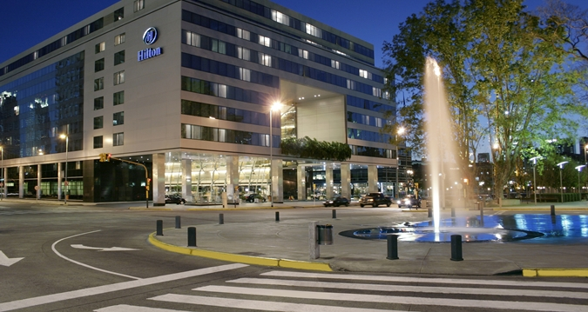
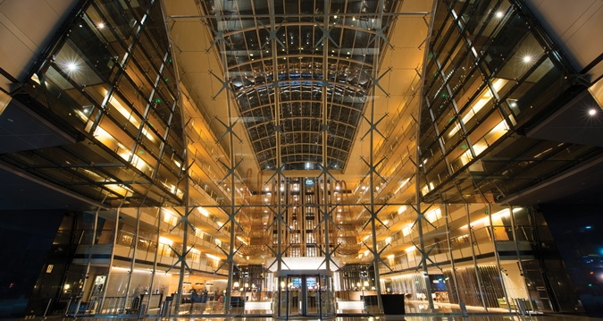
WTDC-17: Venue
Hilton Buenos Aires
Address: Av Macacha Guemes 351
Buenos Aires, Argentina.
www.hilton.com
Bloque de texto

Slide 5

General Information
Hotel accommodation & booking:
https://www.itu.int/en/ITU-D/Conferences/WTDC/WTDC17/Pages/item.aspx?ItemID=350
Airports:
https://www.itu.int/en/ITU-D/Conferences/WTDC/WTDC17/Pages/item.aspx?ItemID=412
Buenos Aires International Airport “Ministro Pistarini (Ezeiza)”
http://www.aa2000.com.ar/ezeiza
BUENOS AIRES CITY
https://turismo.buenosaires.gob.ar/en/article/buenos-aires-city-guide
All relevant information for WTDC-17 is available in ITU Web page:
https://www.itu.int/en/ITU-D/Conferences/WTDC/WTDC17/Pages/default.aspx

Slide 6

Visas requirements
visas requirements for Argentina available in:
http://www.migraciones.gov.ar/accesible/indexA.php?visas#M
list of Representations in each country, available in:
http://www.mrecic.gov.ar/representaciones
COUNTRIES WITH NO REPRESENTATION can APPLY FOR AN E-VISA:
  Registered participants for WTDC-17 will have to contact their corresponding Representation by e-mail and there get the instructions and requirements in order to get the e-visas.
  A letter from the Applicant´s Administration Authority who validates the registration to the Conference may be needed.
  PLEASE INICIATE THE APPLICATION PROCESS BEFORE SEPTEMBER 22.
Bloque de texto

Slide 7
Dependencia Organizadora
Thank you!
Ministry of Modernization
WTDC-17 local contact:
msukenik@modernizacion.gob.ar
mperezaraujo@modernizacion.gob.ar

